Slide 1

Air Travel Safety
Maddie Bauer
DSC 640
May 29, 2021

Slide 2
Table of Contents
The problem
Investigation
Findings
Key Takeaways

Slide 3
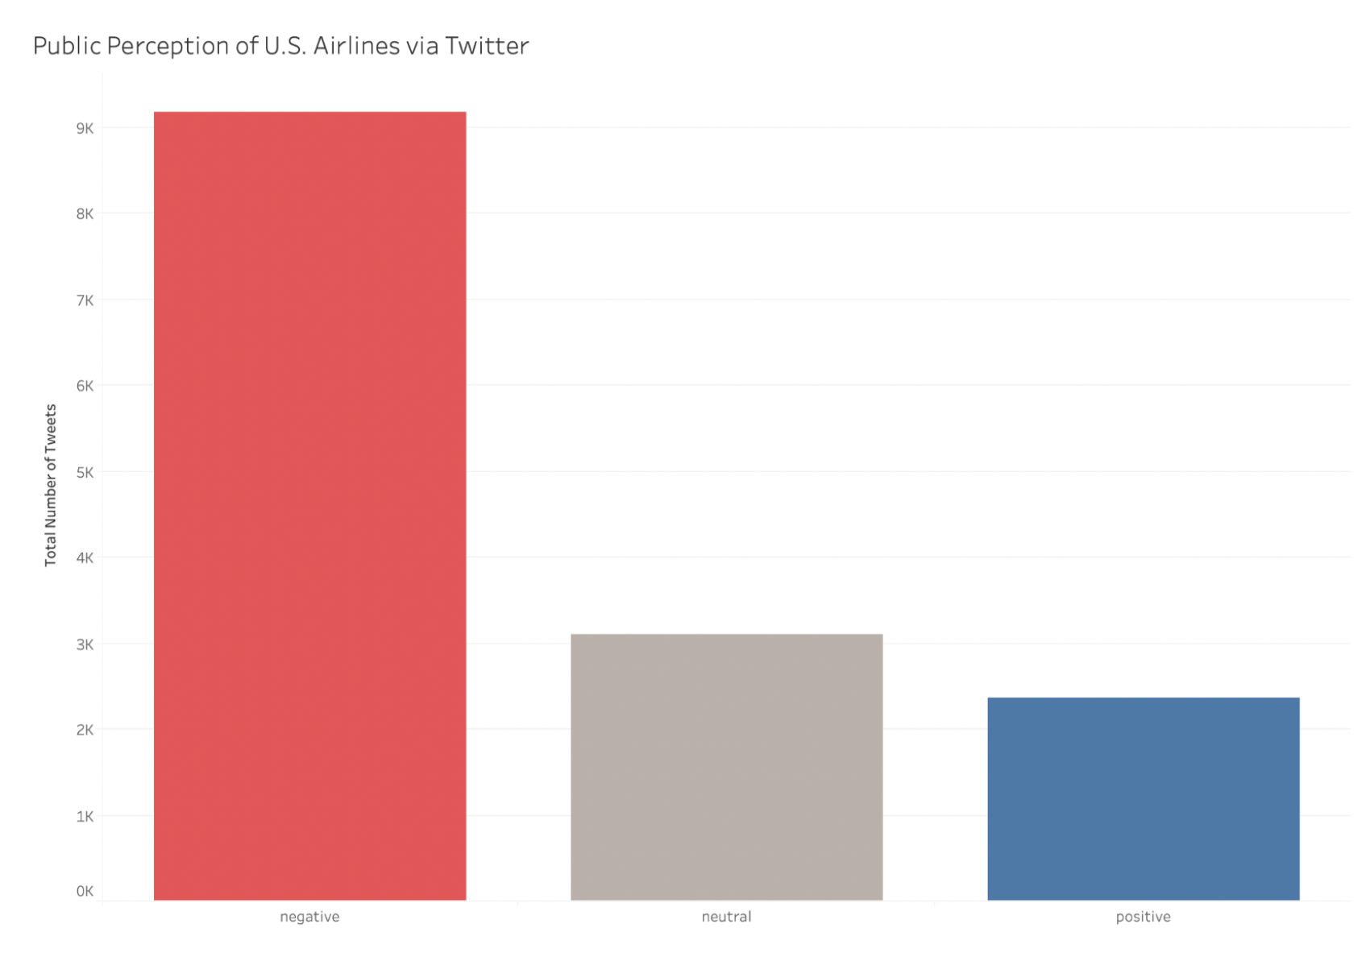
The Problem
Data Source

Slide 4





Odds of Dying by Mode of Transportation 1999 - 2003 Data Source: U.S. Department of Transportation
1 out of 7,700
1 out of 306,000
1 out of 2,067,000
1 out of 91,500
1 out of 410,000

Slide 5
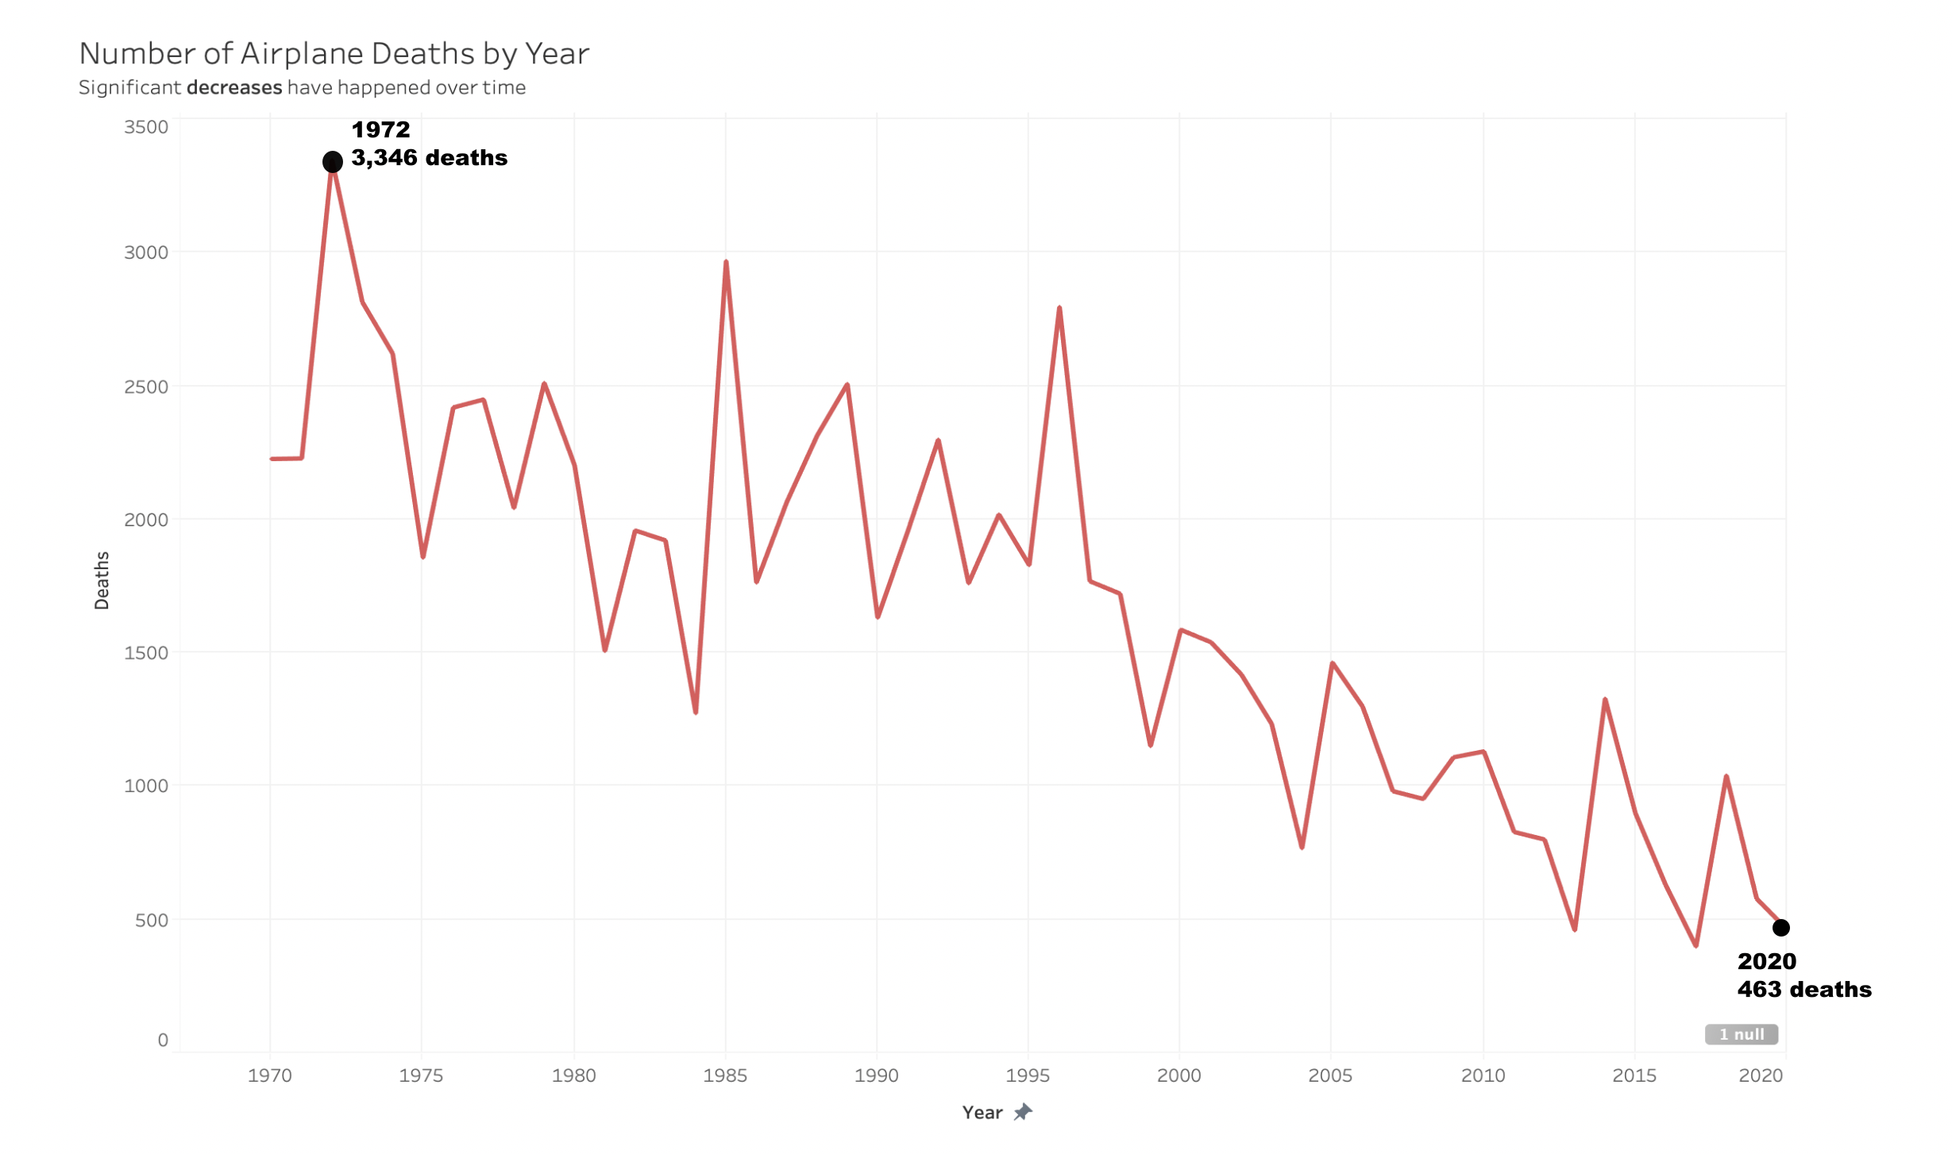
What is the trend?
Number of deaths continue to decline consistently over time
Data Source

Slide 6
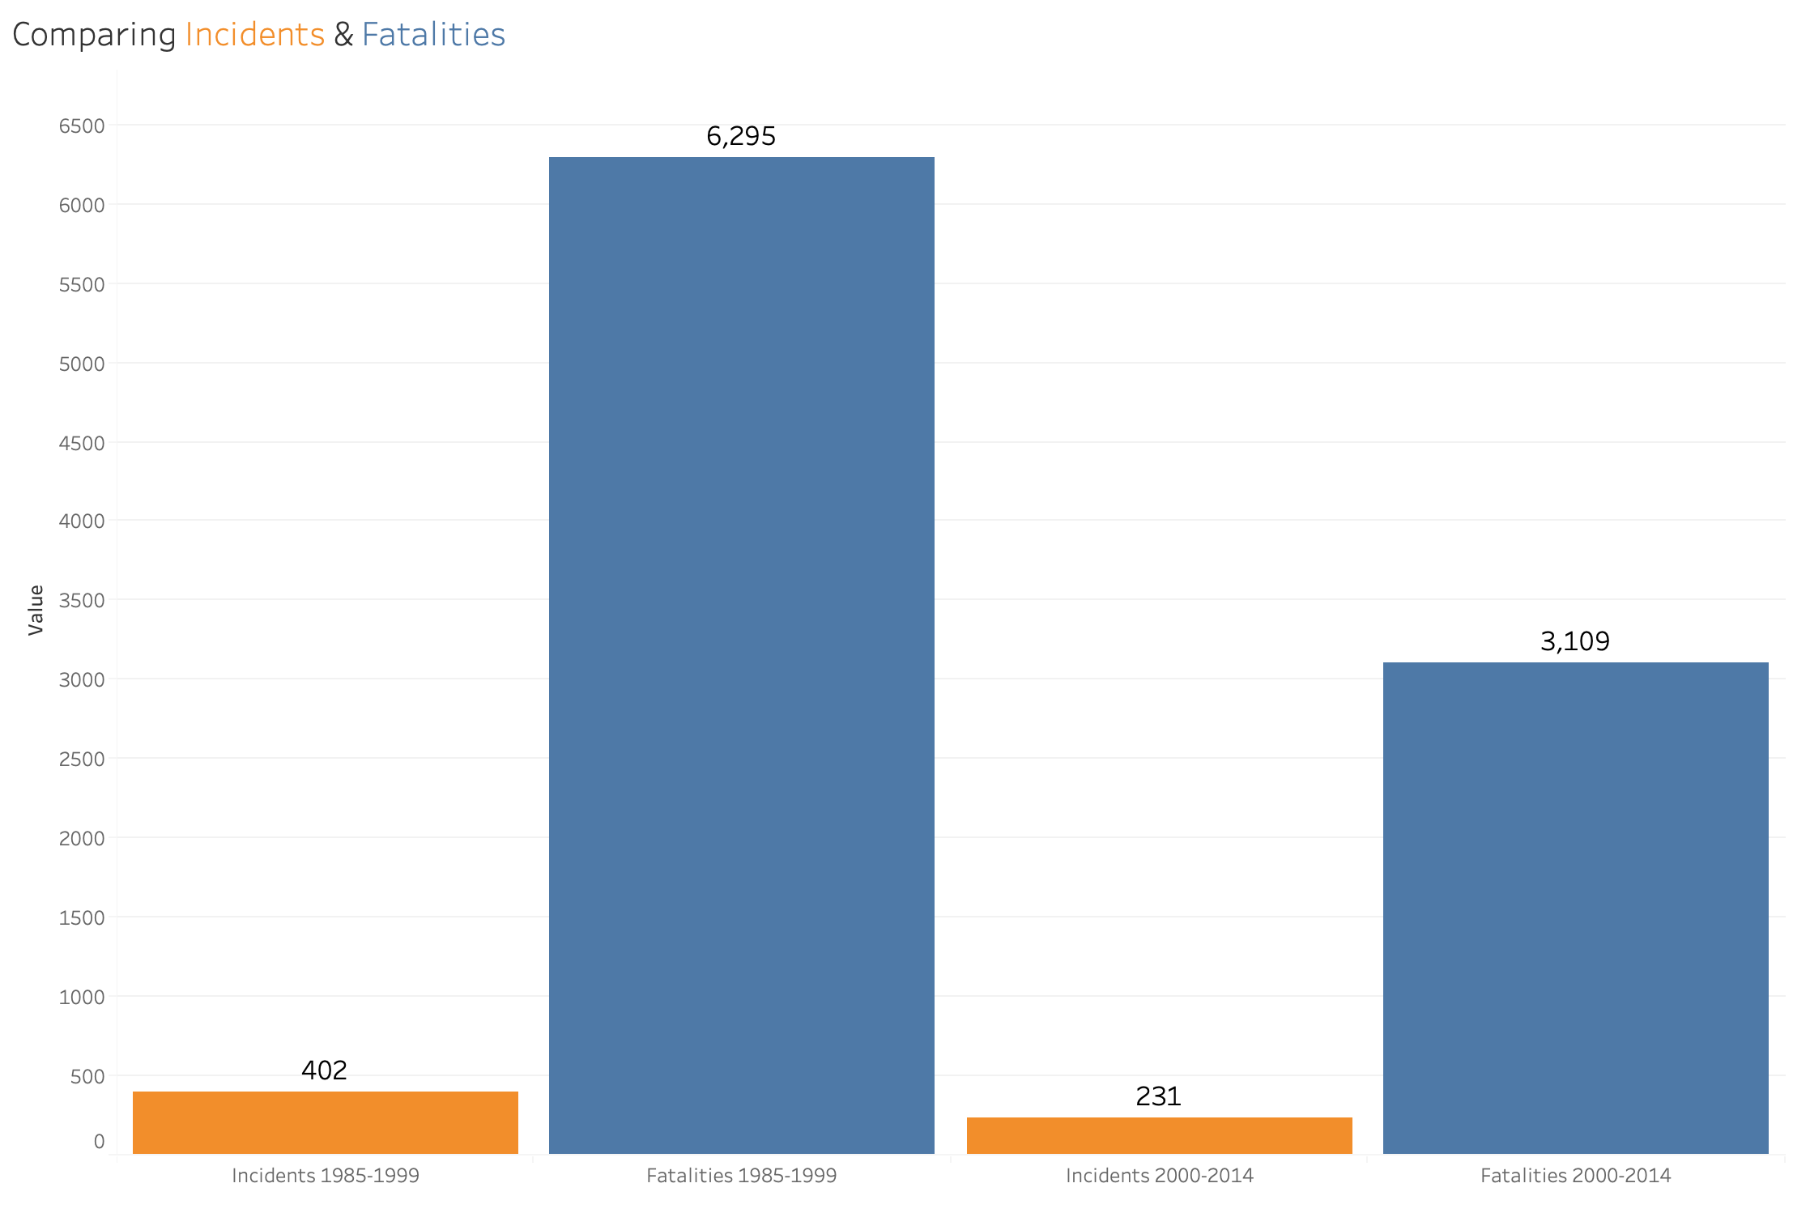
Both the number of fatalities and the number of incidents are decreasing over time.
Data Source

Slide 7
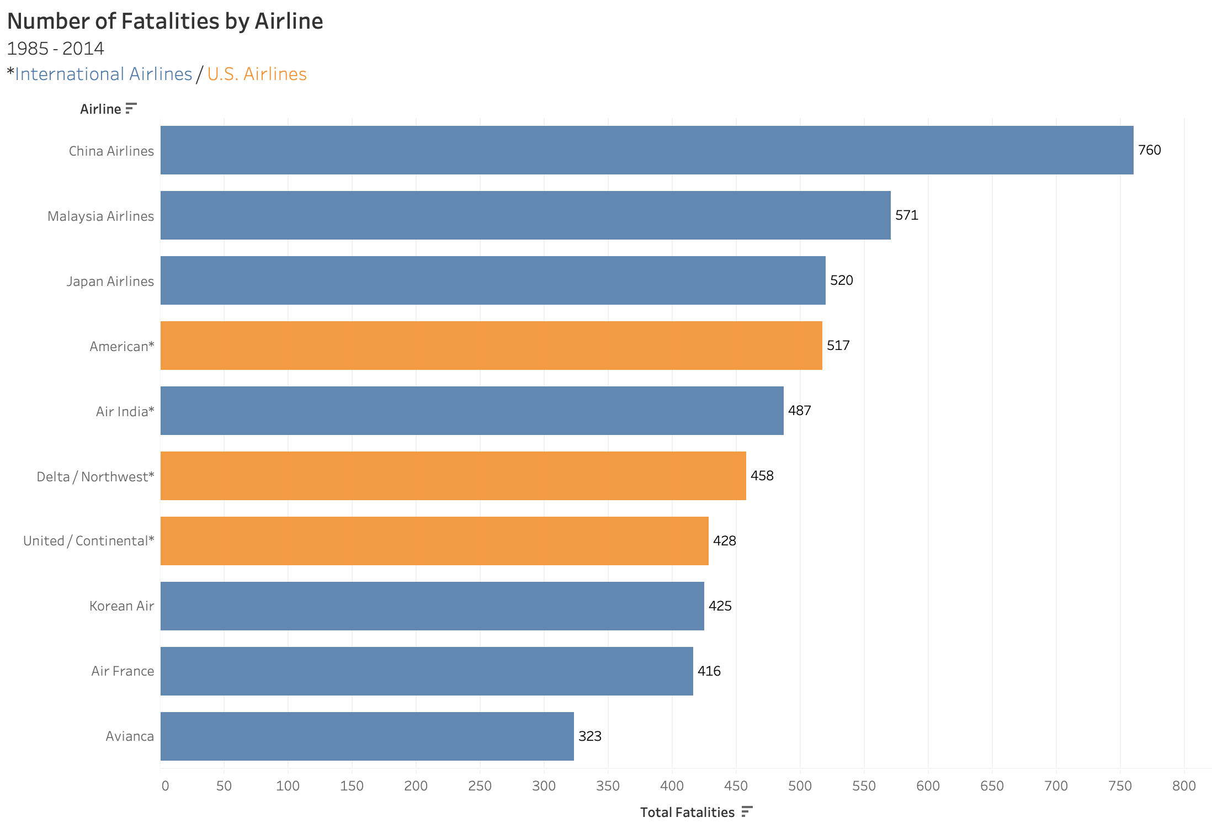
1985-2014 U.S. Airlines are not among the leading 3 when it comes to fatalities
Data Source

Slide 8
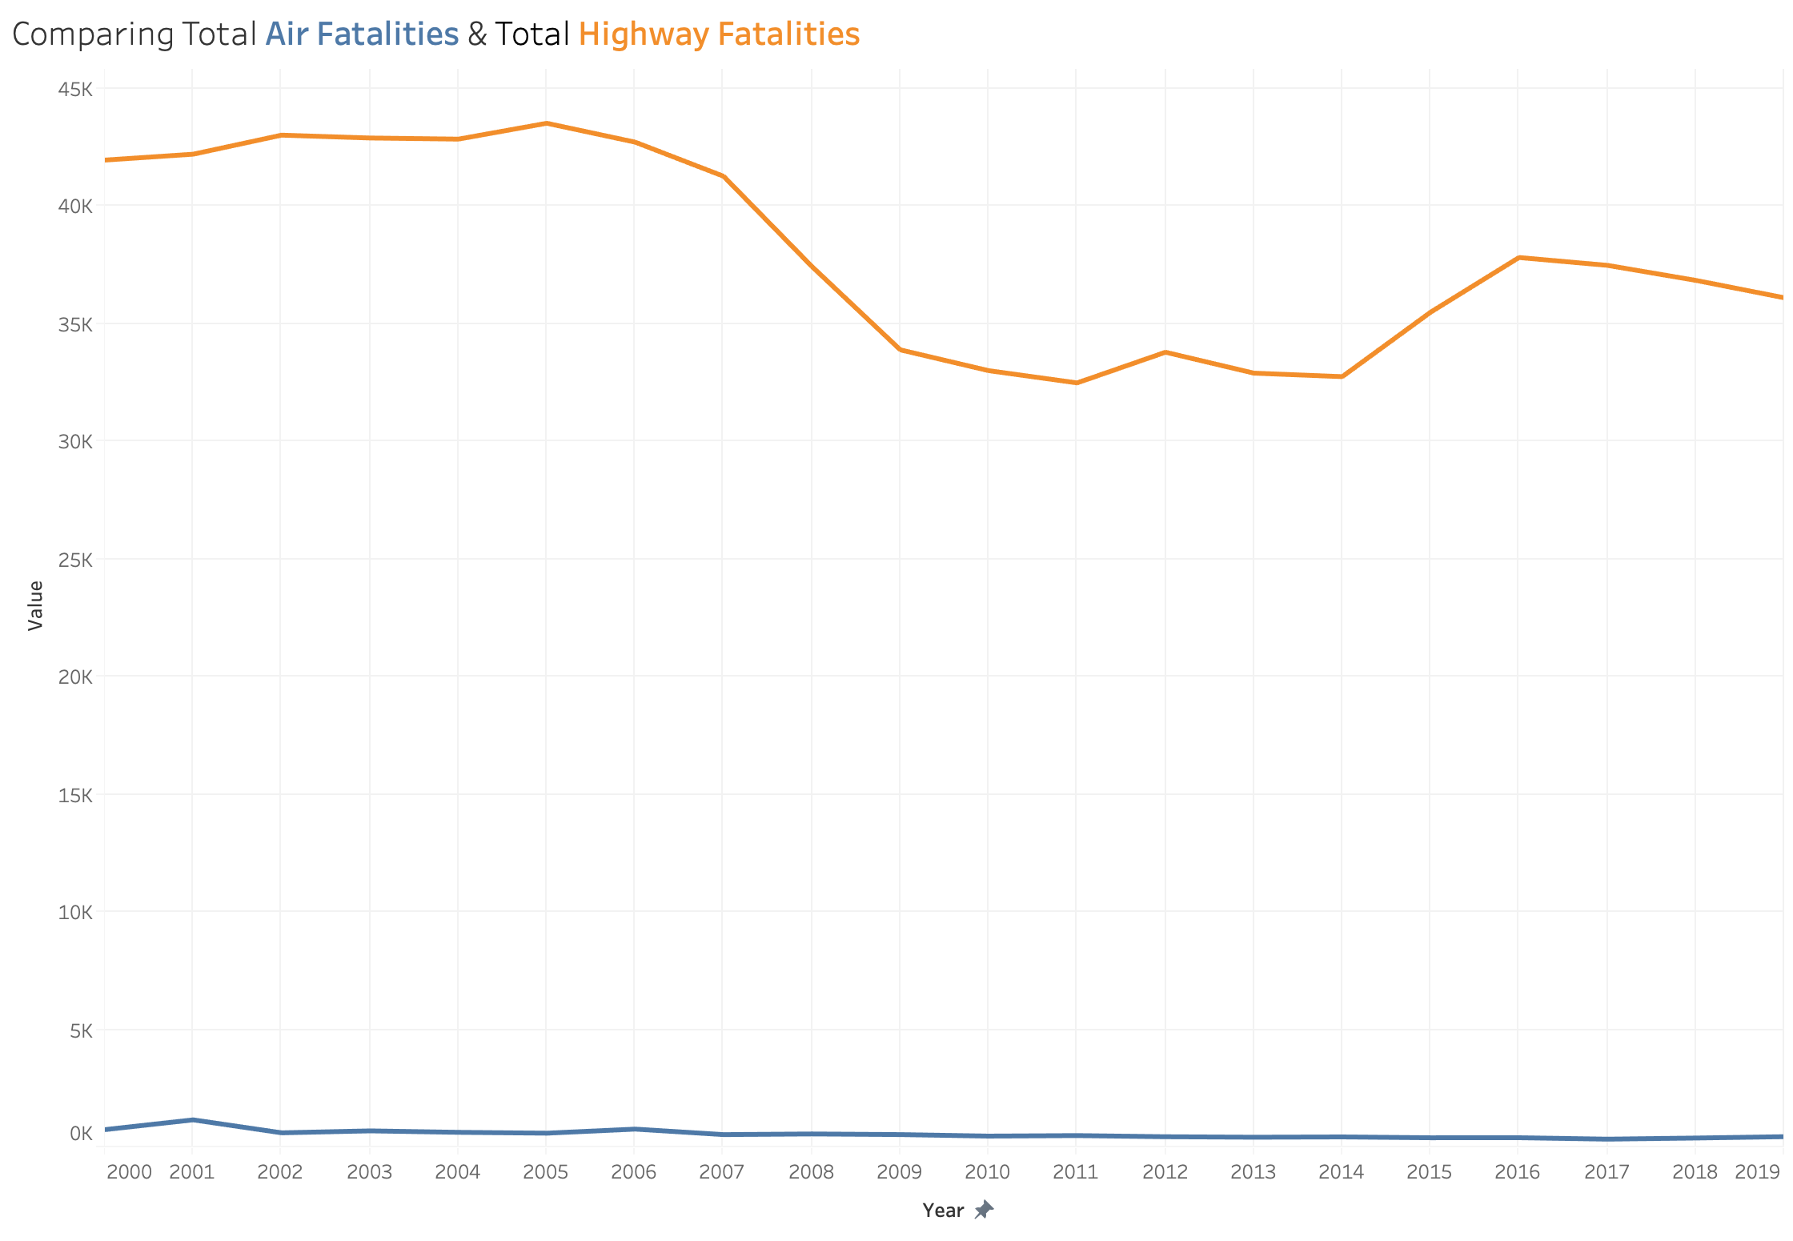

We are 268 times more likely to end up in a fatal car accident than a plane crash.
Data Source

Slide 9

Key Takeaways
Social media is steering people away from air travel
Keep yourself informed
Air travel is 268 times safer than cars
U.S. airlines have lower fatality rates compared to
international airlines
Don’t be afraid to book your next flight!

Slide 10

Thank you!

Slide 11
References
Aviation Accidents and Incidents. Retrieved May 31st, 2021 from https://en.wikipedia.org/wiki/Aviation_accidents_and_incidents
Ropeik, D. (September 2006). How risky is flying? Retrieved May 31st from https://www.pbs.org/wgbh/nova/planecrash/risky.html
GitHub Airline-Safety Dataset https://github.com/fivethirtyeight/data/tree/master/airline-safety
Twitter Sentiment Analysis Dataset https://www.kaggle.com/crowdflower/twitter-airline-sentiment
Total Airline Fatalities and Highway Fatalities Dataset https://www.bts.gov/content/transportation-fatalities-mode

